Slide 1
Capstone Project - Battle of Neighborhoods
1/14/2020

Slide 2
Introduction
I am a data science student currently pursuing master degree in the University of Michigan, Ann Arbor. I hope to find a job in New York after graduation. New York is a big city unlike Ann Arbor, I would like to find a affordable place to live in Manhattan with easy access to metro station and similar venues to my current location in Ann Arbor.

Slide 3
Problem
This project aims to find living location in New York City the resembles to the currently area I am living in. It should meet the following criteria: Apartment with min 1 bedrooms with monthly rent not exceed 3000USD/month; area should locate close to a metro station with walking distance of 1 mile; area with amenities and venues similar to my current location in Ann Arbor.

Slide 4
Data Acquisition
The data acquired for this project is a combination of data from four sources.
- Foursquare API
- Manhattan_rent_price.csv
- Manhattan_metro_station.csv
- Manhattan_boroughs.csv

Slide 5
Methodology
Use Foursquare API to find venues around Ann Arbor area
Use Folium to mark available apartments in Manhattan
Use Folium to mark available metro station in Manhattan
Use Folium to mark available venues in Manhattan
Use geopy_distance and nominatim to establish relative distance
Consolidate all resources in one map
Make selection

Slide 6


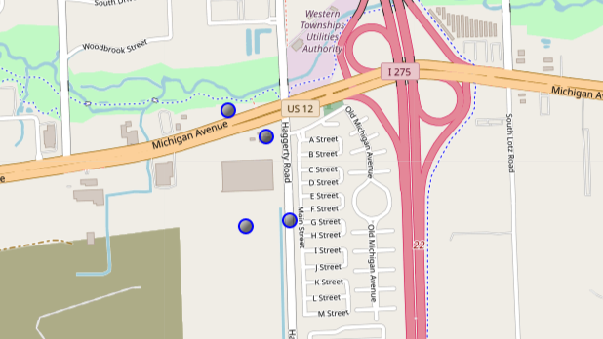

Current residence in Ann Arbor
z

Slide 7
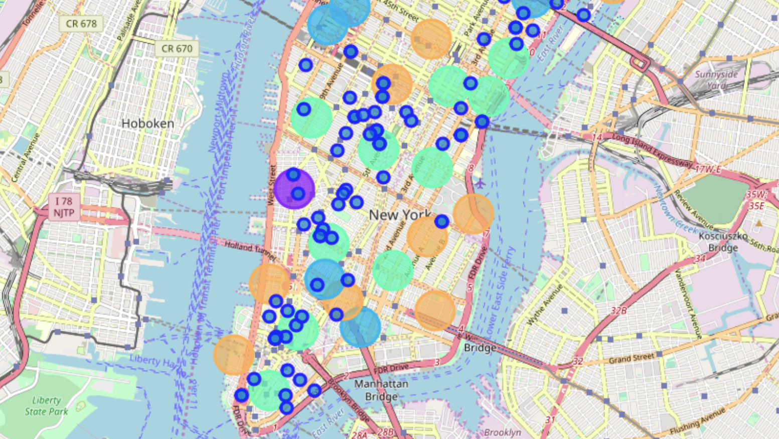
Manhattan Map
z

Slide 8
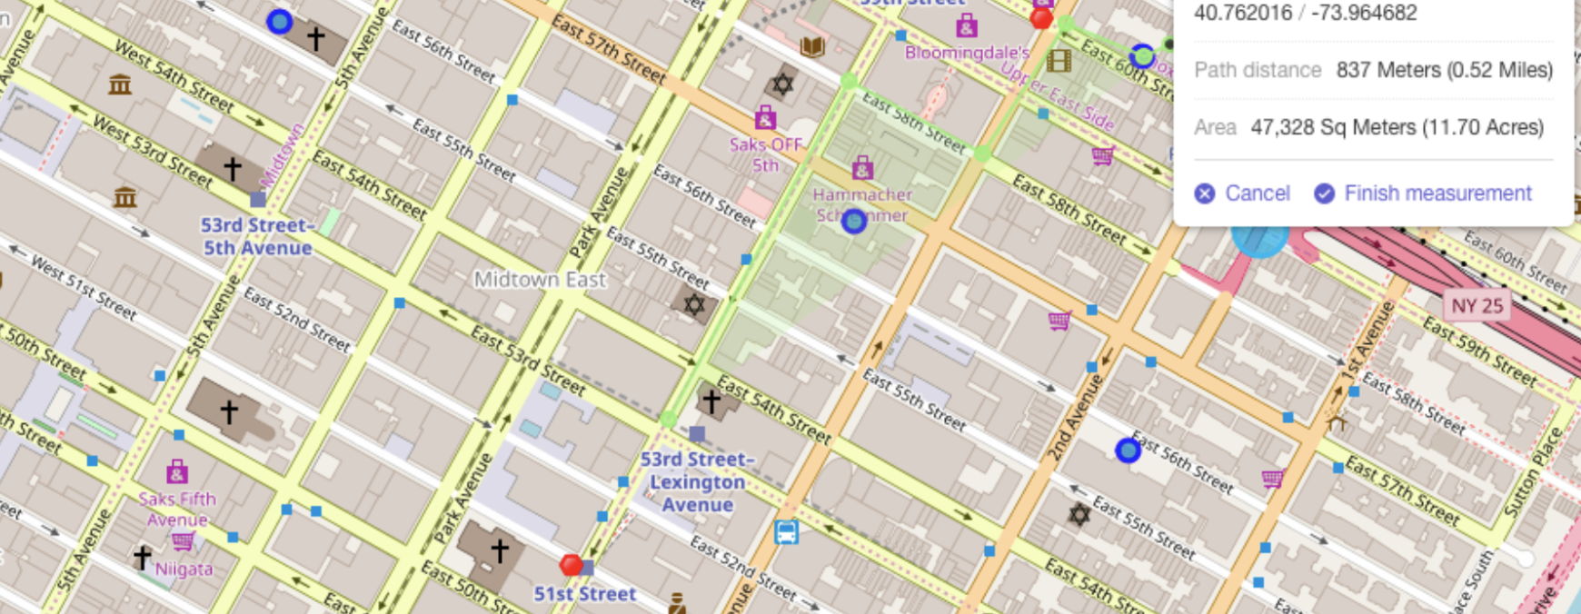
Select apartment
z

Slide 9
Discussion
Overall, it is a lot of work to obtain the final result. Data are limited and incomplete which needs a lot of processing. The housing price changes every month or everyday even. I hope to get more recent data next time.
Conclusion
Folium is a very powerful tool for data scientist to consolidate information and visualize it. Foursquare API contains amazing information's as well. I will certainly add this to my toolkit for future usage.
New York is certainly a much larger city than Ann Arbor. So there are more venues around each neighborhood for one to choose.

